Slide 1
Strategic Planning
Developing Strategic & Action Plans

Slide 2
Strategic Planning: Why It Makes a Difference, and How to Do It
Taking action before problems get to a crisis level is very important in our organization
Strategic planning will provide a framework of making daily decisions following a far-reaching vision, develop a path for our practice, and maximize our options for affecting our environment (Strategic Planning: Why It Makes a Difference, and How to Do It. (2009).
Notes:
Life Sciences Incorporation is an organization operating in the Oncology practice. As we all know, the industry is exposed to drastic changes in technology, reimbursement, and marketplace, to name a few. As an organization, we may be unable to control the future, but with a strategic planning we can develop a path for our practice and also capitalize on our decisions for impacting our environment. Failure to adopt a strategic planning, our firm will perhaps take action only to handle the immediate issues- a type of crisis management framework. Therefore, strategic planning will provide us with a model of how to make daily decisions following a greater vision. As a result, it is recommended that we focus on the Strategic Planning principles that will highlight procedures that our practices will adopt for both short-and long-term planning because we currently need to make strategic decisions more than ever to achieve success in our oncology practice.

Slide 3
Why Do It?
Strategic planning is a tool that will move our practice towards achieving the goals we set.
Of all the impelling reasons for us to adopt a strategic plan, certainly the most significant element is the pace through which the elements in our environment change.
There are various aspects that we may not even be aware they will impact our practice because there is a rapid change on the world that swirl around oncologists.
Notes:
Adopting a strategic planning process is associated to pros in addition to the rusting planning. For starters, engaging every person in the same room will facilitate collegiality and develop a milieu whereby we will very focused on the path of our practice, and go beyond patient care as well as other duties. Additionally, strategic planning will foster and open as well as a creative exchange of ideas, that will include collective tabling of disagreements and work out effective solutions to success. We need to upgrade our practice because physicians who keep a similar practice like in five years ago will be at a very substantial disadvantage and we should all be committed to ensuring we achieve the best and remain competitive in our industry.

Slide 4
Short-and Long-Term Planning
Whether long-or short term strategic planning, we should first establish the path of our practice and define the overarching goals.
In the healthcare field today, a long-term strategic planning will perhaps address no more than the next three years.
Our group should be meeting at least once in a year after determining the strategic course n the initial planning phase.
Notes:
At the ongoing of such stages, group members need to keep revisiting our practice goals, have an updated environmental assessment with current data, and define the strategies required to handles such problems that are expected to emerge in the next one year. For instance, when the retirement of multiple or one member is approaching, a succession planning might be needed to be created . In the meantime, patent volume growth can lead to recruitment policies for both physicians & midlevel practitioners.

Slide 5
Should We Use a Consultant?
Using an external facilitator is often costly but consulting a strategic planning expert involves various significant merits that will drive success.
An expert has done this previously for numerous times and will direct the practice effectively.
The professional probably understands the collection and analysis of diverse data, including practice data, opinions, and market reports.
He or she will then present the collected elements concisely and save us and the entire administration a lot of working time.
Notes:
A consultant is a moderator and he or she definitely understands how to control a team towards progress, preventing such a team from getting bogged down concerning the side factors, and objectively helping the members to resolve disputes and create effective solutions.
Probably the substantial added value by a professional is guidance about environmental assessment. A qualified strategic planning expert will always have both detailed and recent national trends’ update related to the oncology practice. Given our community, despite our team naturally knowing the local marketplace very well, an external consultant can create a fresh as well as an objective perception: as a fact, the physicians’ familiarity with the local market may develop blind spots.

Slide 6
Arranging a Strategic Planning Session (Who, When, & Where)
Strategic planning cannot be defined in one significant way and this means that it also cannot be conducted in one significant way either.
Strategic planning should be conducted by the decision makers of the exercise.
In case our practice is very big that there might be an unwieldy meeting to engage all members, having a smaller team like the executive will be of use (Harrison, 2016).
We should also set aside at least one strategic planning day, distribute agendas before time, and use a consultant to always keep the meeting on path.
Notes:
Other than engaging shareholders, we may need to engage key managers and physician associates. Engaging non-members, at east for some sections of the meetings, may also be an added advantage because it can lead to buying-in to the strategic way and contribute to the success of the final action plan. For example, we can engage the clinic’s executive director and help him to gain valuable understanding for the special administrative as well as practice oncology needs. The strategic planning location should also be conducive and confidential to facilitate the members’ focus and attention solely on the strategic planning process and without being interrupted to cover all the patient-related issues.

Slide 7
Starting Point: Mission & Values
The first strategic planning step is to develop a mission statement for our practice- a basic purpose statement.
It is very productive when we determine how to articulate our mission other than just writing it down.
The next step is to create our value statements based on our core beliefs related to patient care and community interaction.
Notes:
Defining how to articulate our mission statements will set the foundation for a later prioritization, and the activity will oblige our shareholders to express and reflect on the objective of our practice. For example, we will define whether our entire mission is to provide cancer patients with high-quality care and focus on the research to achieve such a goal. In creating our vision statements, it is recommended that we focus on making sure that our team express the enduring factors of our practice that will establish a base whereby the direction of our practice will be expounded. Given that our practice is hospital based, our mission and values should remain consistent with those of the bigger organization. We might end up being confused when the larger organization and our practice will follow different paths.

Slide 8
Vision: Where Do We Want to Go?
After defining the mission and values, the next step needs the group to determine the types of practices we will need in the future.
Whether a long document or just some few words, a visions statement will create the desired picture of the future shape of our practice.
As an hospital, a vision statement will determine if we need recognition for treating a specific kind of cancer, being leader in our state for clinical research, and if we anticipate growing bigger and access links to practice sites.
Notes:
Our vision should complement our working environment and we will find out that our internal and external environment review (SWOT) will help us in revising our vison statement more as we progress with our strategic planning process. Also, our vision statement should not be detailed but rather painted in broad strokes to reflect the end result, and not the achieving strategy. In general, developing a mission statement will need a climate of openness to drive more thinking and creativity beyond the existing borders. During all the strategic planning stages, conflicts may surface and lead to different views concerning our practice. Therefore, one role of strategic planning meeting is to engage everybody at the same time to define where we disagree or agree and settle on a common solution.

Slide 9
SWOT Analysis
SWOT Analysis will be used in assessing the strengths, weaknesses, opportunities, and threats of our business and is divided into two parts:
Internal assessment of the strengths & weaknesses, and
External assessments of the opportunities & threats.
Notes:
This analysis facilitates our assessment on our strengths, weaknesses, opportunities, and threats of our working environment and serves as a strategic planning staple.
In the analysis, a mixture of both quantitative & qualitative data is used, with most of the data collected and assessed before scheduling the planning meeting.
The information collecting process and the SWOT analysis differs widely and the process is influenced by the group’s size and how faster changes occur both locally and globally. (Figure 1)

Slide 10
Internal Assessment: Strengths & Weaknesses
In defining the internal strengths & weaknesses, we shall involve hard data like the drugs’ costs per full-time-equivalent practitioner, the amount of new consultants, and the financial reports.
It is also advisable to benchmark both efficiency and quality aspects of the business against the data on the other practices of oncology.
Notes:
Also, it will be good to examine the individuals’ perceptions outside our activities like hospital administrators, patients, and the referring physicians. For instance, a consultant naturally has the benefit in collecting sensitive assessments from these people, unless when an anonymous survey is in use. How these individuals view our practice will also be significant in conducting an effective SWOT analysis. We are advised to collect qualitative data and views from the staff and physicians related to what they consider to be the top challenges facing our practice, and what they see as strengths & weaknesses. Such views and opinions can be discussed in the meetings, but the data should be gathered before.

Slide 11
External Assessment: Opportunities & Threats
This involves data related to the marketplace of the business like economic trends, demographics, competition, and referral patterns (Bertelsen, 2012).
Such aspects need to be analyzed based on if they reflect opportunities or threats.
Also, the regional healthcare system as well as the emerging changes in regulation and reimbursement need to be assessed.
Notes:
Given that staff and physicians in some of the teams often stay abreast of the regional, local, and global trends, a professional consultant with oncology market forces will always be of help to facilitate an environmental analysis. Some of the teams may worm to stay abreast with the trends on their own by active engagement in both regional and global oncology societies. Keeping an eye on the environment will need commitment and energy to benefit because it will pay off in the raw intelligence marketing we will get, as well as staying in touch consistently rather than a once-an-annual report.

Slide 12
Developing Strategies
After establishing a clear image of both our practice and the environment, our group will be developing strategic decisions that will move our practice from its existing status towards the expected future level.
Therefore, we should be careful with thee pitfalls related to defining operational challenges and attempt to make decisions on tactics rather than defining strategies.
Notes:
For instance, one of the strategic decisions can be to move forward with the implementation of an electronic system for medical records, but we find out that the strategic planning meeting is not where we can discuss about the systems available, required training, or preferred data sources. Therefore, controlling such types of significant information will be the role of every assigned individual in the action planning.
On the other hand, a SWOT Analysis can define weaknesses that need implementation on one or multiple strategic priorities prior to handling others. Sometimes practices realize that they have to develop the necessary infrastructure to achieve their goals. Notably, the group can define numerous strategies that should be prioritized at a subsequent meeting or during the meeting.

Slide 13
Action Plan
Developing strategies’ results should be the perception of a few achievable strategies and established associated action plans.
Most of the strategic plans have failed or faltered due to being very complex or very ambitious.
Therefore, we should avoid taking advantage of each opportunity or handle each threat defined in the SWOT Analysis.
Notes:
Some of the goals can be critical but may be planned for implementation after one or two years. With an annual strategic planning meeting to keep our plan updated, such goals will remain in sight and may be successfully addressed.
The bottom line is to develop an action plan that will address every strategic priority across the next 12 months. Then we should spell out the recommended steps for action, those charged with the leading responsibility, and the milestones for showing progress.

Slide 14
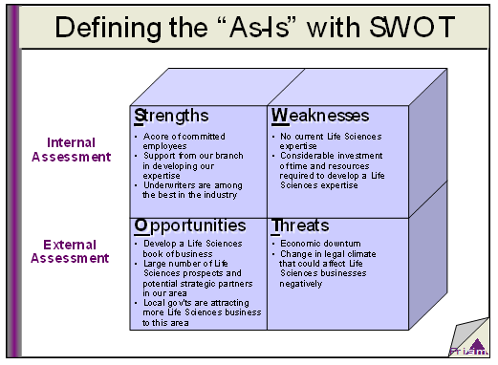
SWOT Analysis

Slide 15
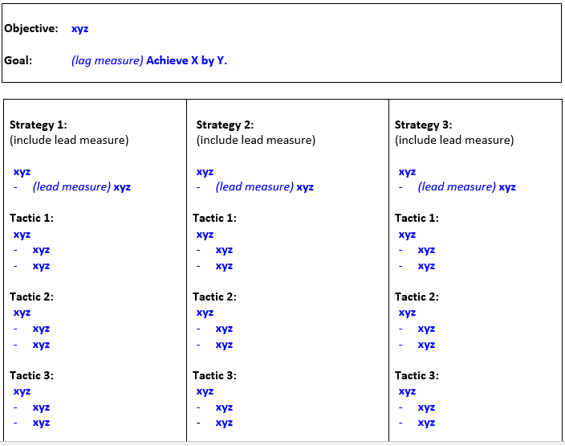
Sample Action Plan

Slide 16
References
Bertelsen, B. (2012). Everything you need to know about SWOT analysis. Newmarket, Ont.: BrainMass Inc.
Harrison, J. P. (2016). Essentials of strategic planning in healthcare.
Strategic Planning: Why It Makes a Difference, and How to Do It. (2009). American Society of Clinical Oncology.

